Slide 1
Introduction to Structured Programming
Types, variables, assignment, cout and cin

Slide 2
Basic structure of a program
The basic structure that will be used for the duration of the course is the following:
#include <iostream> // inclusion of library. This library, iostream,
// will enable us to use utilities for reading and writing
using namespace std; // instruction specifying the namespace used by default
int main() // function first executed when launching the application
{
cout << "Hello World" << endl; // call to the cout function, // in order to display a message
system("pause"); // causes the program to pause
return 0; // instruction that returns a value at the end of
// the execution of a function
}

Slide 3
Adding comments
There are 2 ways to add comments in code:
// comment text this syntax serves to make a comment out of a single line of code
Example:
int age; // This variable records the age of a user
/* comment text */ this syntax serves to make a comment out of one/many lines of code found in between the two tags
It is very important to not abuse comments in code, or else you can significantly reduce its readability, as well as reducing its pertinence in the medium/long term.

Slide 4
Data types
There are multiple data types predefined in C/C++.
It is also possible to create your own data types (this aspect will be studied later in the program).

Slide 5
Data types
The basic integer data types are:
NAME | SIZE (bytes) | RANGE OF VALUES
bool | 1 | false / true
char | 1 | -128 to + 127 (2⁸ ⁻¹)
unsigned char | 1 | 0 to 255 (2⁸)
short | 2 | -32 768 to 32 767 (2¹⁶⁻¹)
unsigned short | 2 | 0 to 65 535 (2¹⁶)
int | 4 | -2 147 483 648 to 2 147 483 647 (2³²⁻¹)
unsigned int | 4 | 0 to 4 294 967 295 (2³²)
long long | 8 | -9 223 372 036 854 775 808 to 9 223 372 036 854 775 807 (2⁶⁴⁻¹)
unsigned long long | 8 | 0 to 18 446 744 073 709 551 616 (2⁶⁴)

Slide 6
bool
The bool type (boolean) in C++ is a type that can have only 2 values: 0 or 1, representing false or true.
However, it is possible to assign any numerical value to a bool variable. The rule is:
IF: a non-zero value is passed to a boolean variable or expression
THEN: the result will always be true
ELSE: the result will be false

Slide 7
bool
#include <iostream>
using namespace std;
int main()
{
bool bool1 = 0; // false
bool bool2 = 1; // true
bool bool3 = 2 + 2; // true
bool bool4 = 2 - 2; // false
bool bool5 = true; // true
bool bool6 = false; // false
bool bool7 = -1; // true
bool bool8 = 0.0001; // true
system("pause");
return 0;
}

Slide 8
char
The char type (character) takes an integer as value.
This integer can then be translated as being a value in the ASCII table (a brief search engine search will show you multiple examples of ASCII tables).
#include <iostream>
using namespace std;
int main()
{
char c;
c = 65; // 65: ASCII code for ‘A’
cout << c << endl; // displays ‘A’
system("pause");
return 0;
}

Slide 9
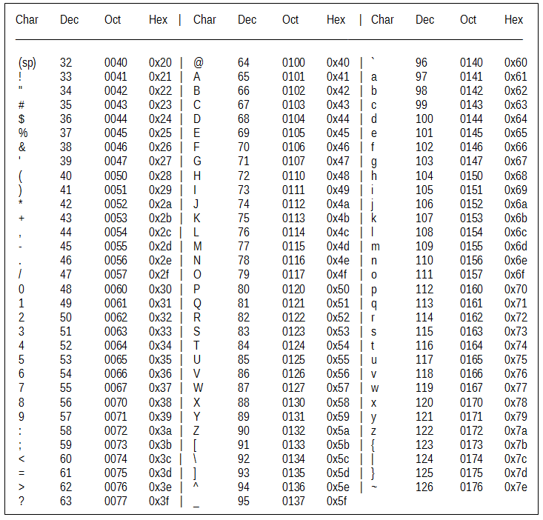
char
The values of char variables always represent the decimal value in the ASCII table

Slide 10
Data types
The basic real number data types are:
You need to be careful when using float variables. This variable type has a much more restricted precision level than the other two types, which can result in unexpected calculation errors and data loss (floating-point errors or rounding errors).
NAME | SIZE (bytes) | RANGE OF VALUES
float | 4 | -3.4E+38 to -1.2E-38, and: 1.2E-38 to 3.4E+38
double | 8 | -1.7E+308 to -2.3E-308 and: 2.3E-308 to 1.7E+308
long double | 10 | -1.1E+4932 to -3.4E-4932 and 3.4E-4932 to 1.1E+4932

Slide 11
float versus double
Code example:
#include <iostream>
#include <iomanip>
using namespace std;
int main()
{
double amountDouble = 50000000.99;
float amountFloat = 50000000.99;
cout << fixed << setprecision(15) << amountDouble << endl;
cout << fixed << setprecision(15) << amountFloat << endl;
system("pause");
return 0;
}

Slide 12
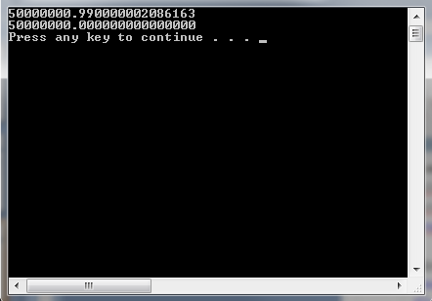
float versus double (result)

Slide 13
How to declare a variable
To declare a variable, you need to know its type and its name. The type will specify the memory space that will be reserved for the variable.
Here are some examples:
A variable containing a person’s age
unsigned short age;
A variable containing the amount for a bill
double billAmount;
Declaring multiple variables at a time (be careful not to reduce the code’s readability)
unsigned int age, nbCourse;

Slide 14
The assignment operator (=)
This operator is one of the most important operators.
Any modification of any variable must use this operator. It is impossible to modify the content of a variable without using it.

Slide 15
The assignment operator (=)
To assign a value to a variable, we can use multiple methods:
#include <iostream>
using namespace std;
int main()
{
int val1 = 0; // at declaration
int val2(4); // at declaration: alternative syntax
int val3;
val3 = 1; // after declaration
val3 = 2 + 2; // result of an arithmetic calculation
system("pause");
return 0;
}

Slide 16
The assignment operator (=)
To assign a value to a variable, we can use multiple methods:
#include <iostream>
using namespace std;
int main()
{
int val1 = 3;
int val2(10);
int val3;
val3 = 5;
// result of a calculation with one or more variables
val2 = val1 + 7;
val3 = val1 + val2 + val3;
system("pause");
return 0;
}

Slide 17
Using cout and cin functionality
In this section, you will learn to use the functions cin and cout, allowing you to:
ask for information input from the user (read), and
display information output to the user (write),
during the execution of the program.
In order to use the cin and cout functions, you need to include the library iostream at the top of your .cpp file. We will also include the instruction allowing us to use the namespace std by default:
#include <iostream>
using namespace std;

Slide 18
Using cout and cin functionality
Because of this inclusion, you will be able to call the functions in the following way:
cin >> <variable name>;
cout << "Hello World";
You can also use the endl function when using cout to add line return/break (new line):
cout << "Hello World" << endl;

Slide 19
Using cout and cin functionality
The direction of the arrows is very important when using these functions.
The term ‘cin’ is an abbreviation of ‘console input’ (reading from the console).
For cin, the arrows always point towards the variable:
cin >> <variable name>;
(information moving from console to program data)

Slide 20
Using cout and cin functionality
The term ‘cout’ is an abbreviation of ‘console output’ (writing to the console).
For cout, the arrows always point toward the cout, a little like if you were to write on the console the text you want to display to the user:
cout << "Hello World";
(information moving from program data to the console)

Slide 21
Using cout and cin functionality
There are also some useful functions that serve to format the displayed text:
defaultfloat [default]: displays numeric values in floating-point notation
scientific: displays numerical values in scientific notation
fixed: displays value in fixed-point notation (decimal value)
Adding the library iomanip allows the following functions:
setw(numericValue): configures the size of the display content following the command
setprecision(numericValue): determines the number of decimal points that will be displayed when displaying the value of real number variables. It is important to format with fixed notation to proprely display values wih two decimal points, in the case of monetary values.

Slide 22
Using cout and cin functionality
#include <iostream>
#include <iomanip>
using namespace std;
int main()
{
double amountDouble;
cout << "Enter an amount (double): ";
cin >> amountDouble;
cout << amountDouble << endl;
cout << "$" << fixed << setprecision(2) << amountDouble << endl;
cout << "$" << scientific << amountDouble << endl;
system("pause");
return 0;
}

Slide 23
Using cout and cin functionality
Add the following line above the main function to make sure that accents are displayed correctly:
locale::global(locale(""));

Slide 24
Exercise
Make a program that asks for the following inputs with cin:
a numerical value stored in a variable of the type unsigned int
a numerical value stored in a variable of the type double
a numerical value stored in a variable of the type bool
a numerical value stored in a variable of the type char
Display all of the variables using cout. Make sure that the double variable is displayed in monetary format with a $ sign before it:
Example: if I enter 5, the console should display $5.00
No input validation is required for the moment.

